Slide 1
Familiarize yourself with phishing attacks
Team | Email open rate | Email click through rate | Phishing success rate
IT | 80% | 2% | 0%
HR | 100% | 85% | 75%
Card Services | 60% | 50% | 10%
Reception | 40% | 10% | 0%
Engineering | 70% | 4% | 1%
Marketing | 65% | 40% | 38%
R&D | 50% | 5% | 2%
Overall average | 66% | 28% | 18%
as shown above, a clear explanation of phishing success rate even though tough countermeasures are already put in place to defend our systems. But due to lack ok seriousness, and lack of knowledge to identify phising leads to compromise of systems most of the times.

Slide 2
What is phishing?
Phishing is a type of social engineering where an attacker sends a fraudulent (e.g., spoofed, fake, or otherwise deceptive) message designed to trick a person into revealing sensitive information to the attacker[1] or to deploy malicious software on the victim's infrastructure like ransomware. Phishing attacks have become increasingly sophisticated and often transparently mirror the site being targeted, allowing the attacker to observe everything while the victim is navigating the site, and transverse any additional security boundaries with the victim.[2] As of 2020, phishing is by far the most common attack performed by cybercriminals, the FBI's Internet Crime Complaint Centre recording over twice as many incidents of phishing than any other type of computer crime

Slide 3
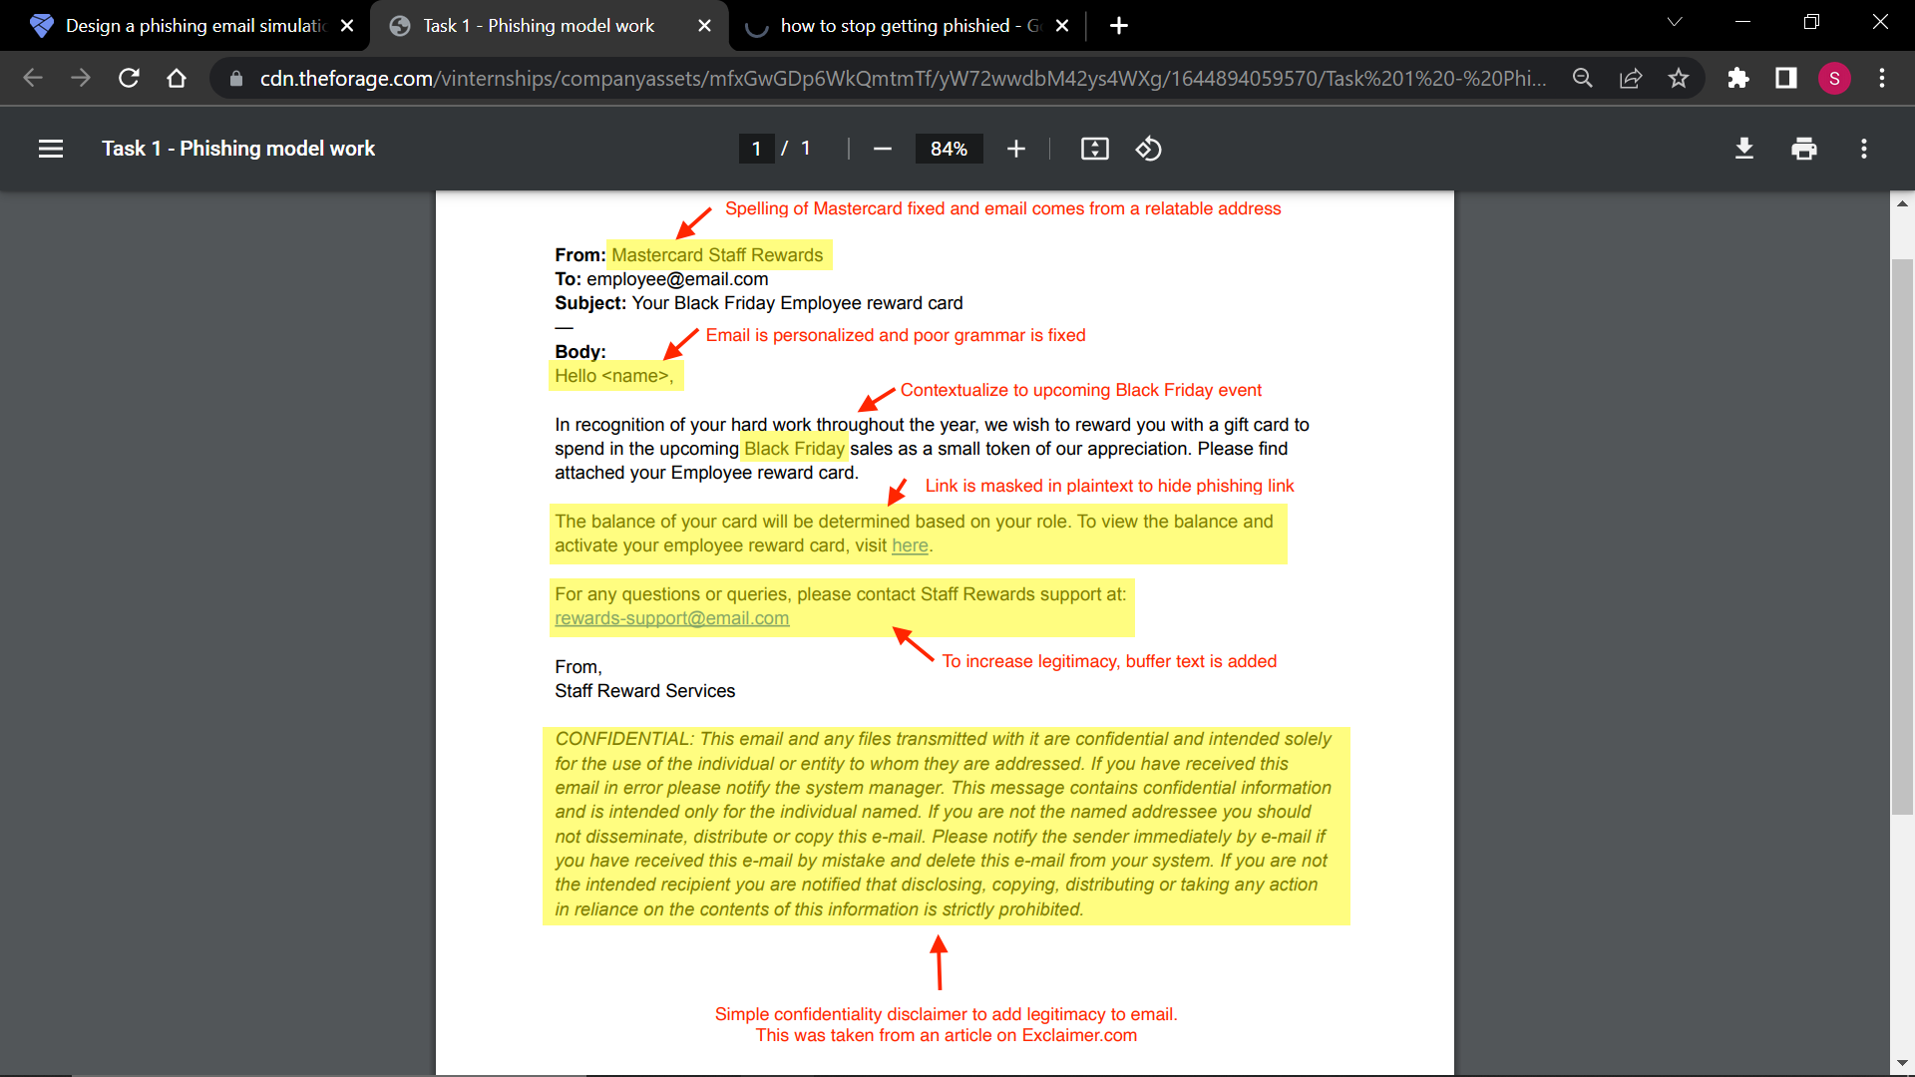
Learn to spot phishing emails

Slide 4
How do we stop getting phished?
1. Know what a phishing scam looks like ·
2. Don't click on that link ·
3. Get free anti-phishing add-ons ·
4. Don't give your information to anyone who you don’t know
5. Verify everything explicitly

